Slide 1
Emotional Release
Sara Fahring

Slide 2
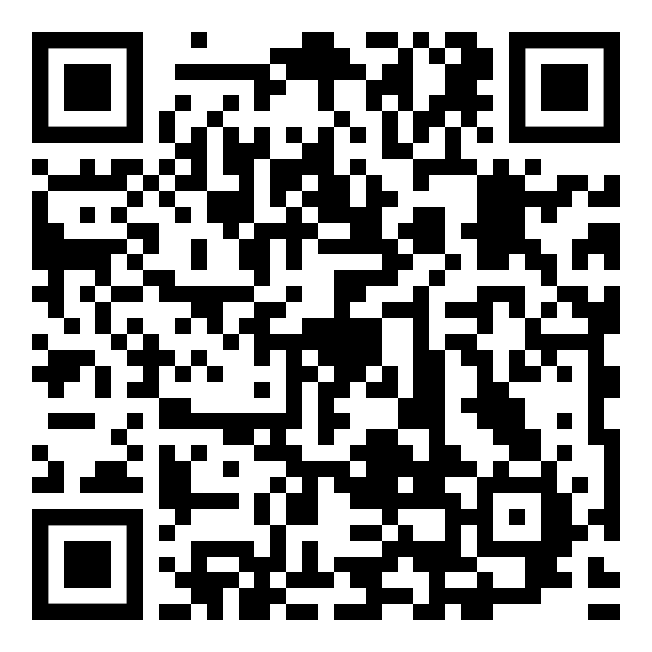
Resources
github.com/DancinFosse/Talks/blob/main/emotional_release.md
Notes:
https://github.com/DancinFosse/Talks/blob/main/emotional_release.md

Slide 3

Setup
Bed
(or Yoga Mat)
2 Pillows
(with pillow cases)

Slide 4
Why?

Slide 5
Why?
Release emotion
Express yourself
Feels good
Healthy

Slide 6


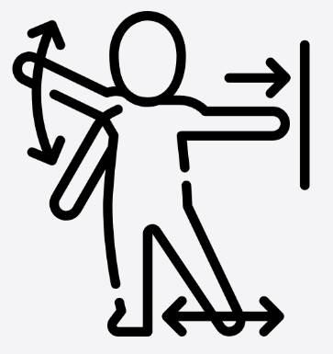
Three Elements of Somatic Release
Breath
Sound
Movement

Slide 7
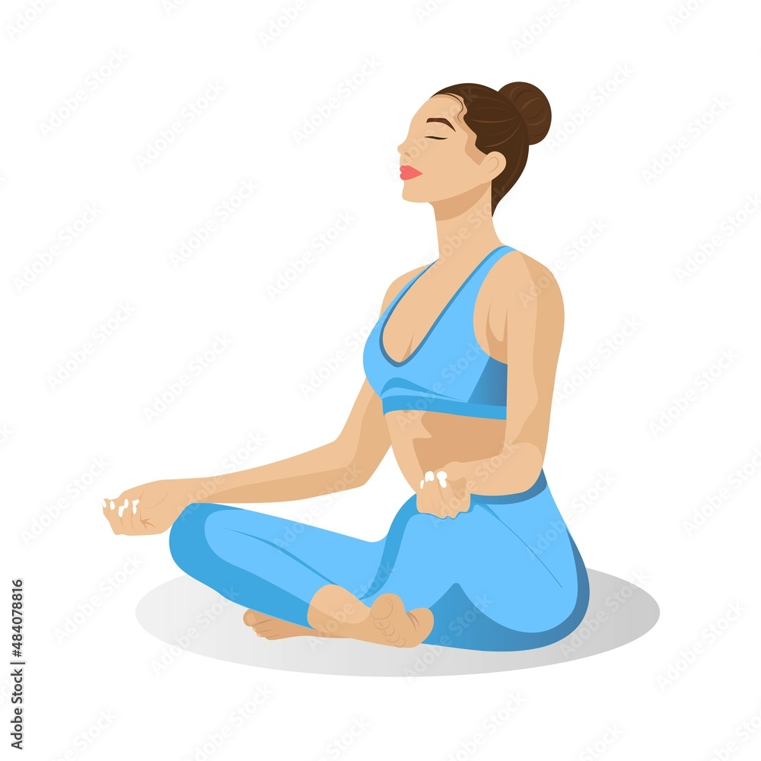
Breath
1. Nose
4. Mouth - Huh
2. Belly - Out
3. Belly - In

Slide 8
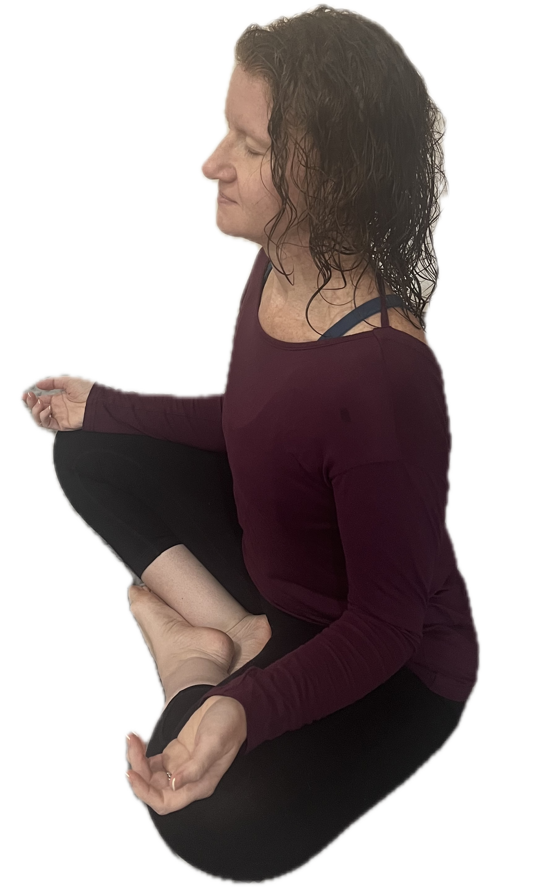
Breath
1. Nose
4. Mouth - Huh
2. Belly - Out
3. Belly - In

Slide 9

Hand Scream
Technique #1
Exhale
“Augghh”
Wiggle

Slide 10
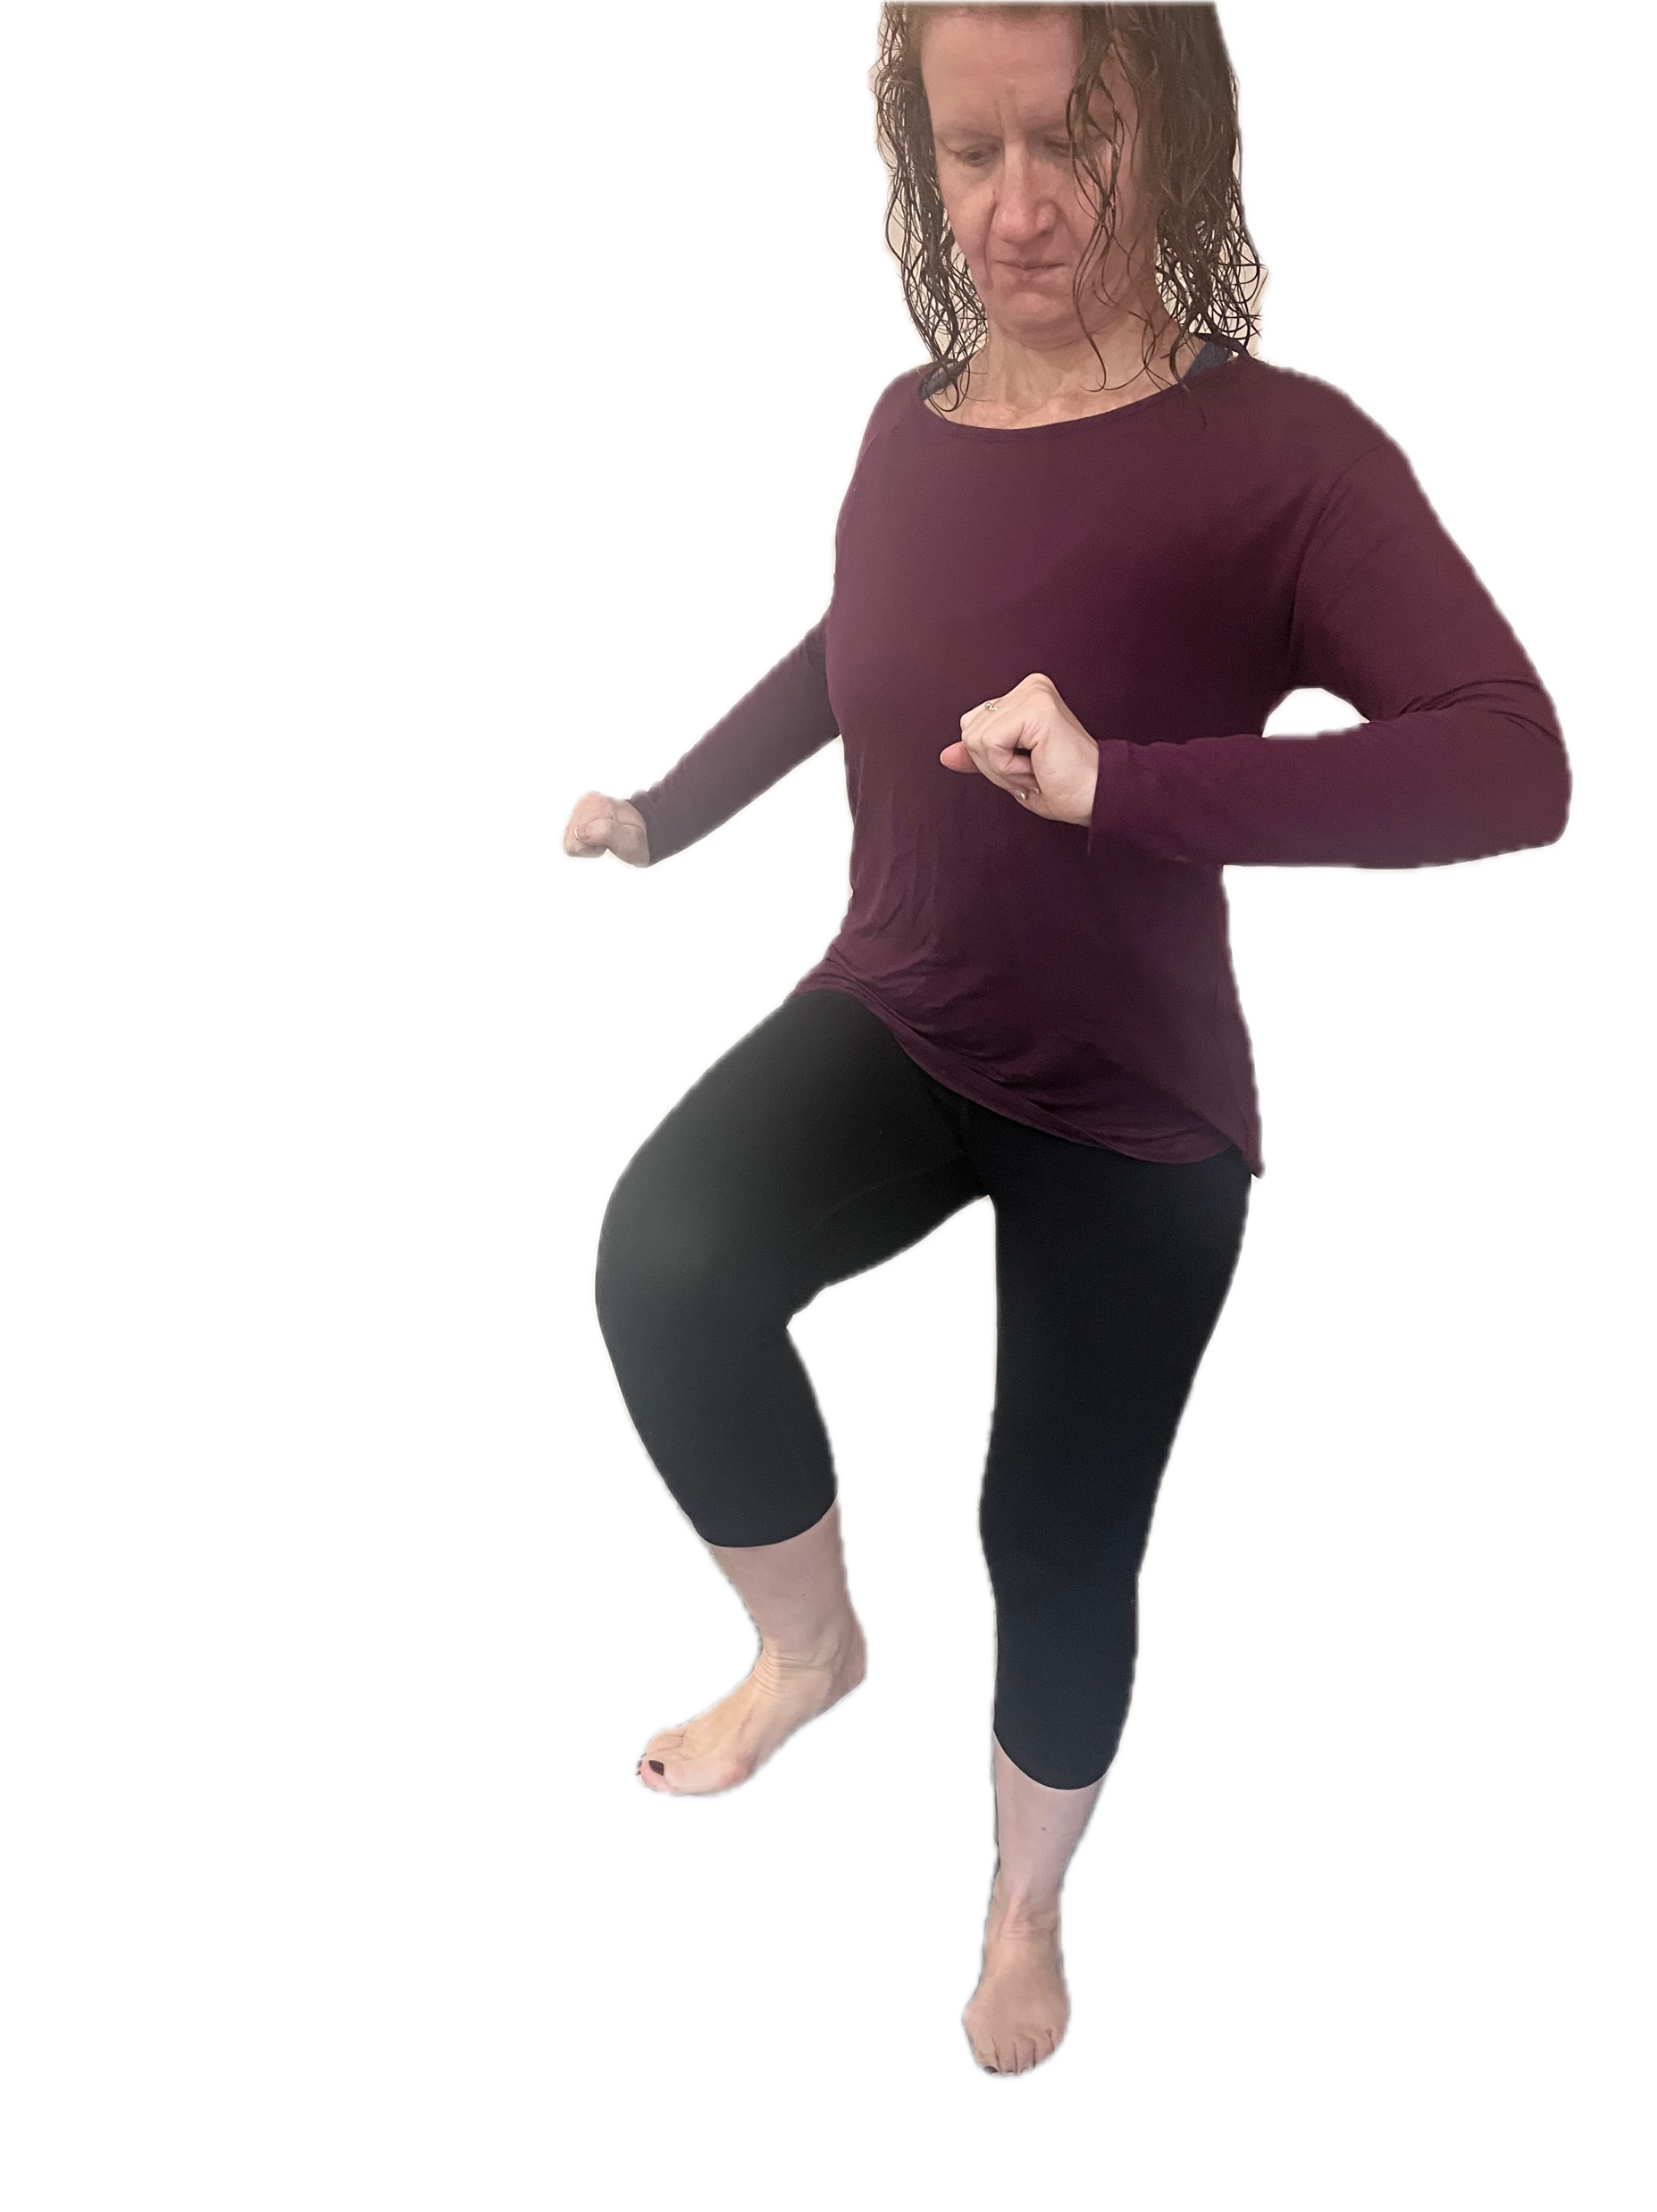
Foot Stomping
Technique #2
Exhale
“NO!”
Stomping

Slide 11
Hand Scream and Foot Stomping
Bonus Technique

Slide 12
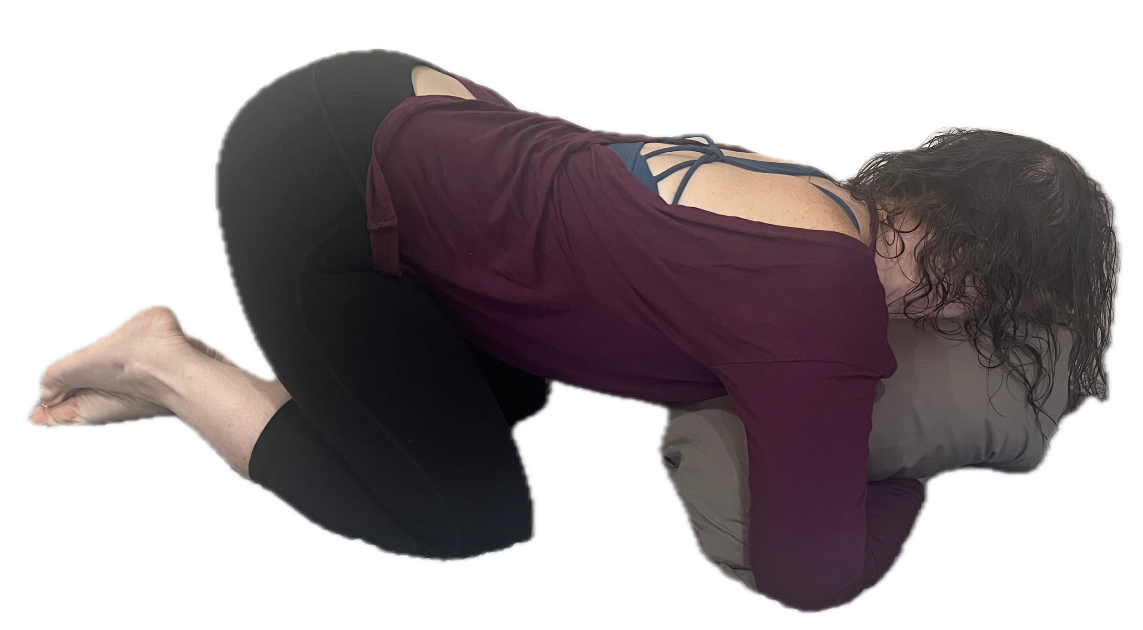
Pillow Screaming
Technique #3
Exhale
Belly scream
Exhale
Wiggling

Slide 13
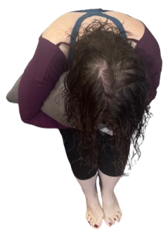
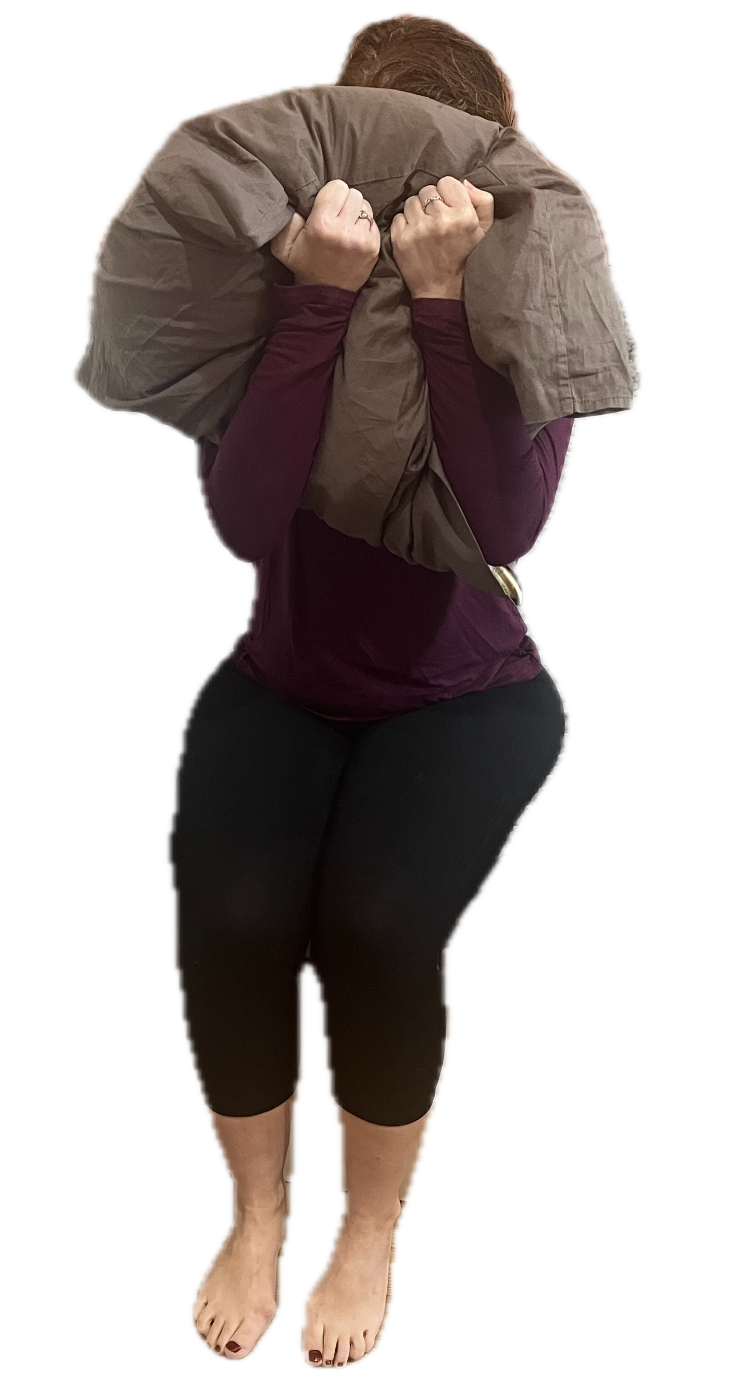
Alternative Positions
Pillow Screaming

Slide 14
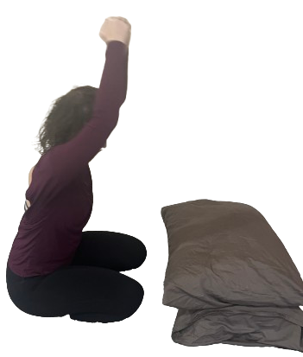
Pillow Pounding
Technique #4
Exhale
“NO!”
Hitting the pillow

Slide 15
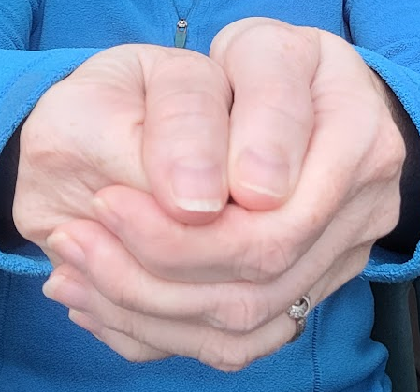
Hand Position
1. Make a fist.
3. Wrap second hand around
the closed fist.
2. Thumb on the outside.
4. Second thumb sits beside the first

Slide 16
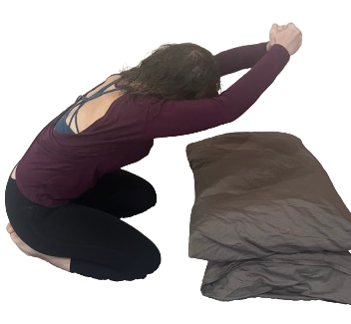
Strike

Slide 17
Hinge

Slide 18
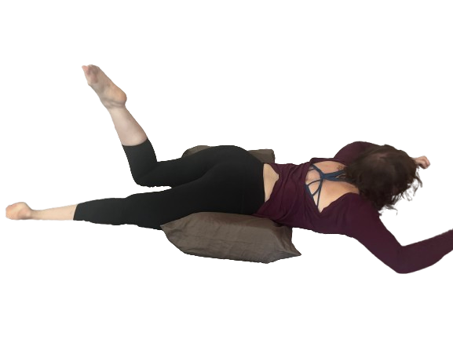
Tantrum
Technique #5
“Ahhh!!”
“I said no!”
Slapping the bed
Stomping feet
Exhale

Slide 19
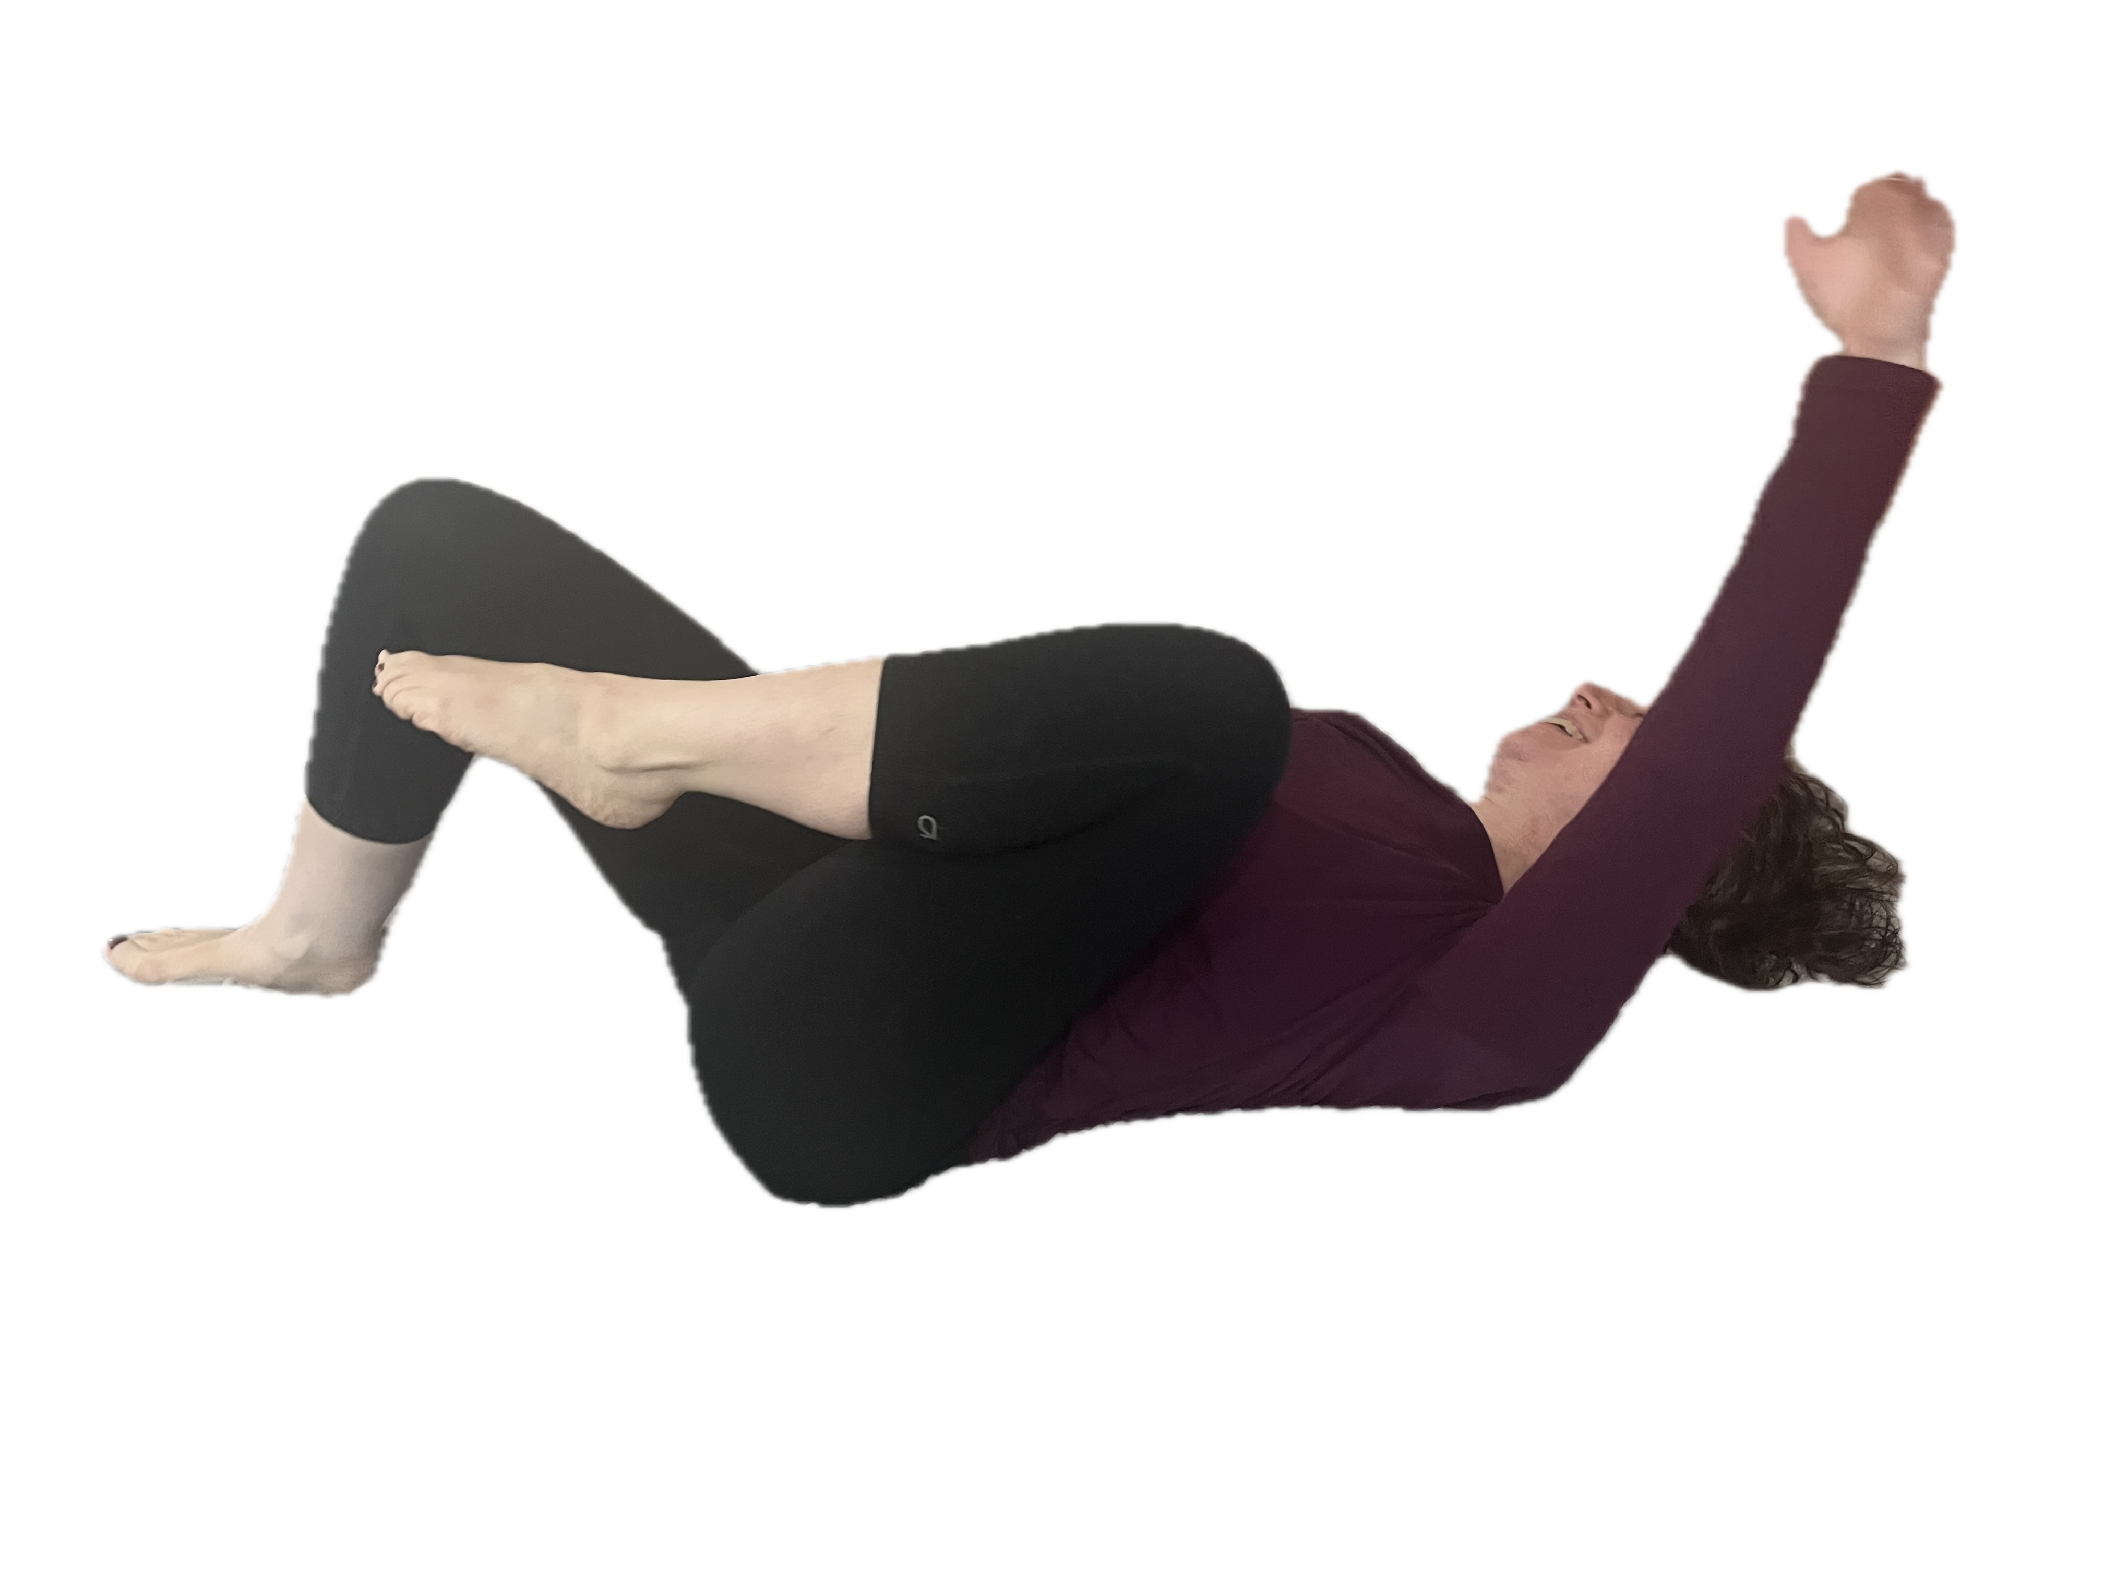
Lying on Back
Tantrum Position #1

Slide 20
Face Down
Tantrum Position #2

Slide 21
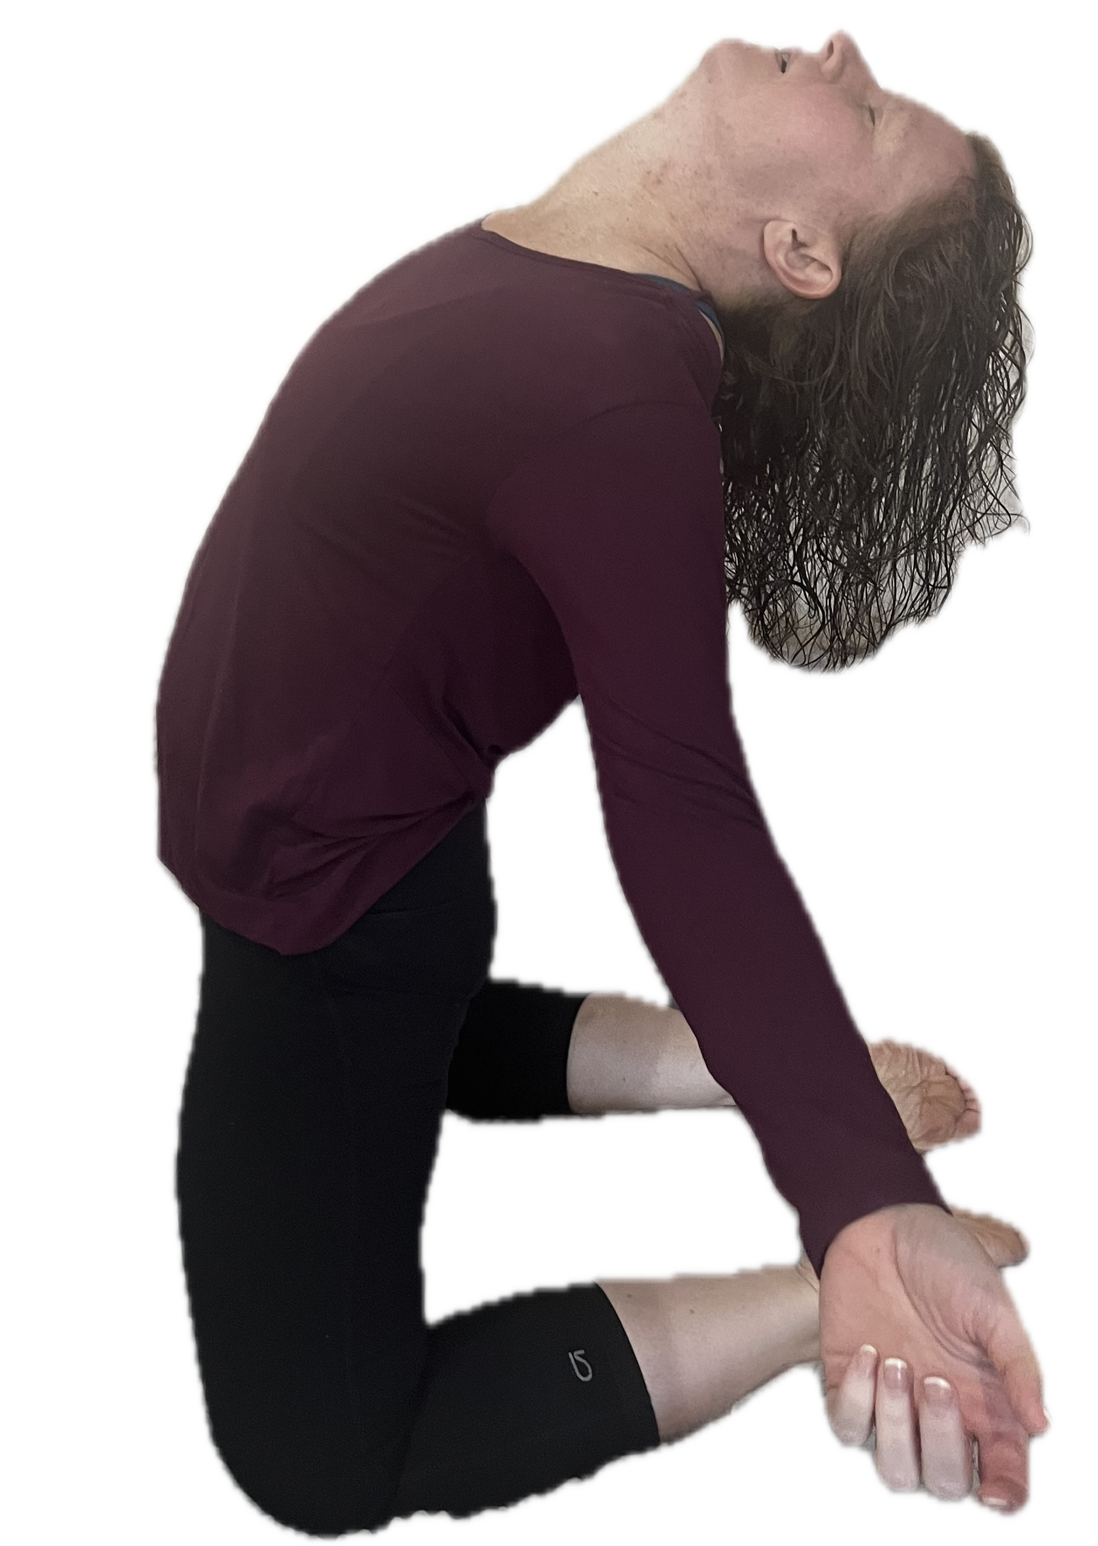
Grief Ritual or Wailing
Technique #6
Cry
Wail
Arms open to
the side,
shoulders back
body shaking
Exhale

Slide 22
On knees
Grief Ritual #1

Slide 23
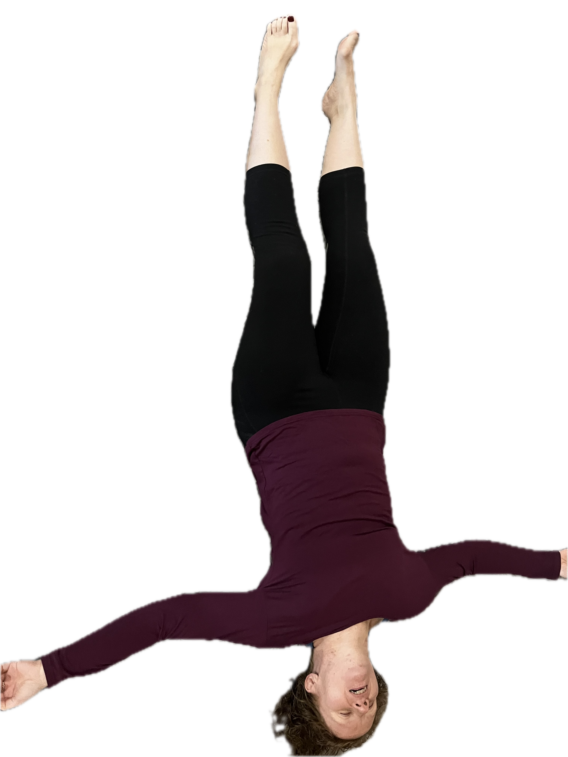
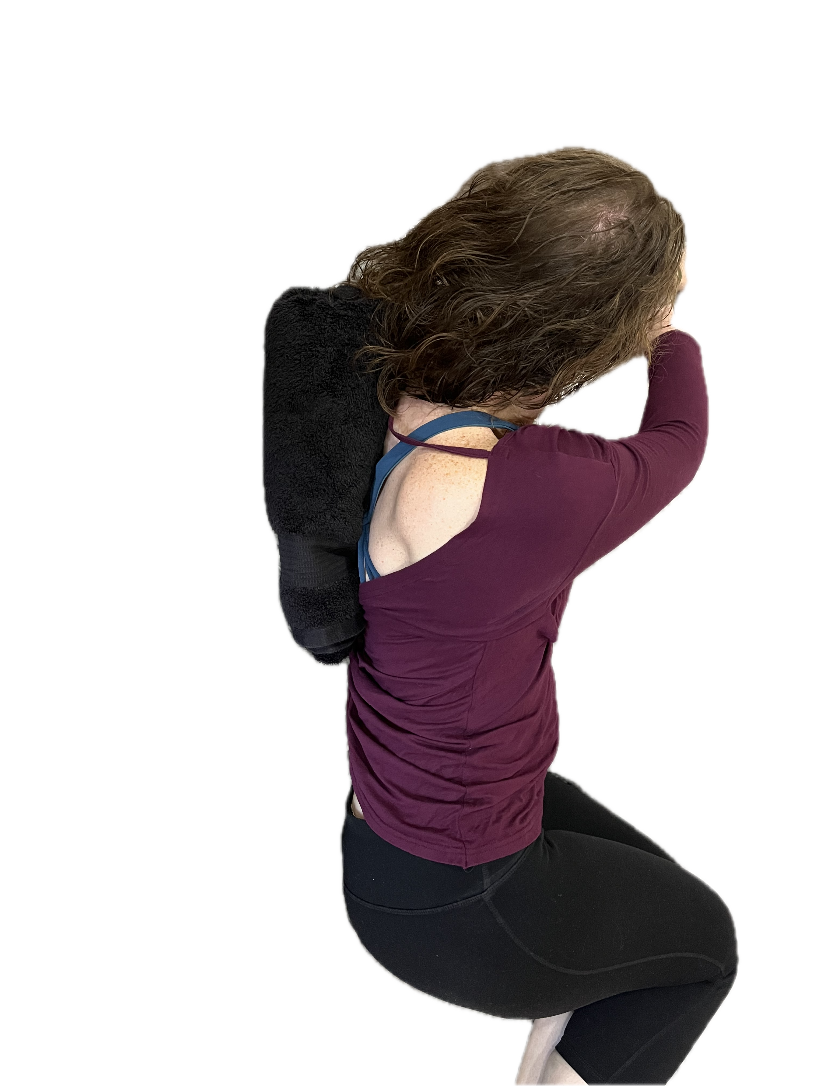
On back with towel
Grief Ritual #2

Slide 24
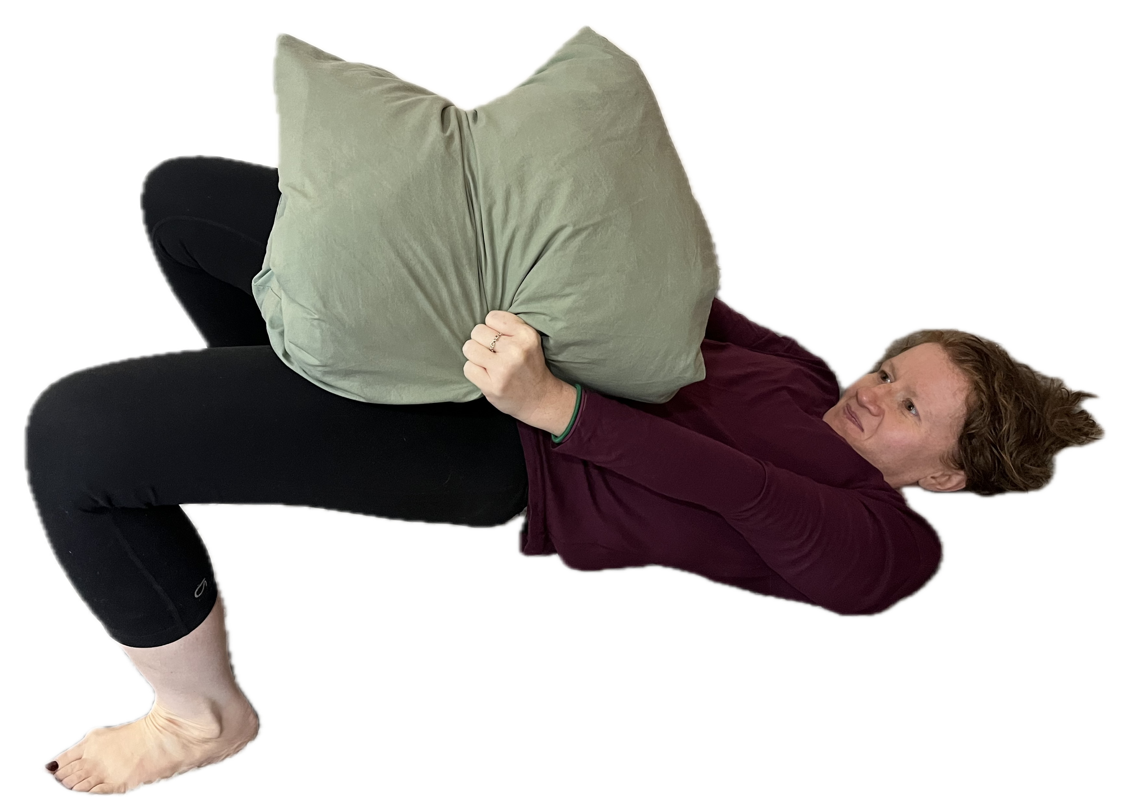
Pillow Humping
Technique #7
Pillow between
knees; Focus
on hip thrusting
“NO!”
“Uh”
Exhale

Slide 25
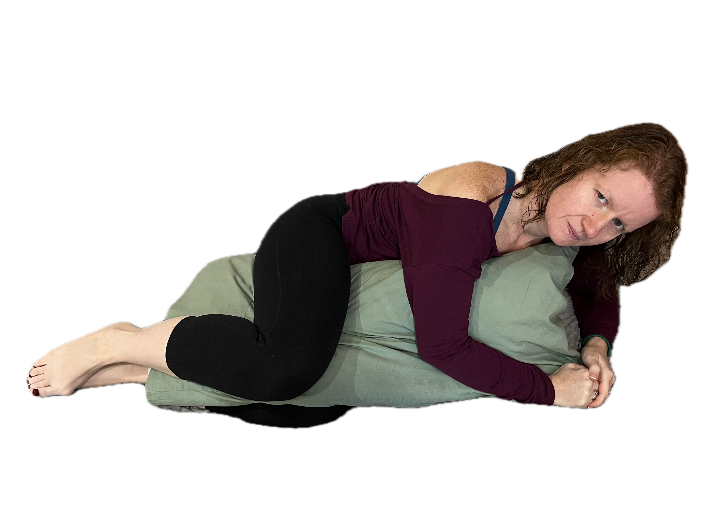
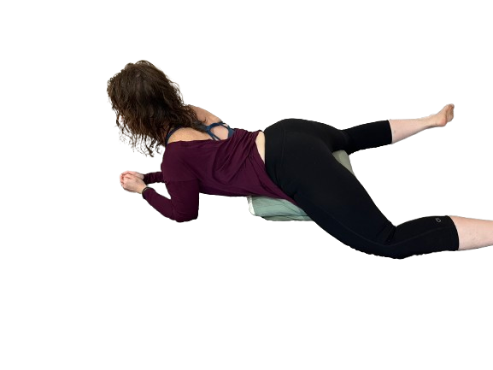
Positions

Slide 26
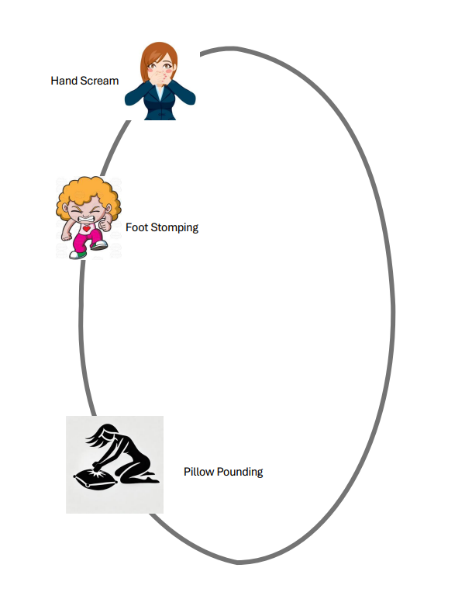

Slide 27

Thank You
github.com/DancinFosse/Talks/blob/main/emotional_release.md
Notes:
https://github.com/DancinFosse/Talks/blob/main/emotional_release.md

